Slide 1


Slide 2
Outline
Welcome! Who am I?
How do I use R in my current work?
Why use R instead of Excel?
3 Examples:
Grouping Aggregate Data
Pre-Post Analysis
Power Analysis

Slide 3









Who am I?
B.S. Biology
M.P.H
Molecular Epidemiology Ph.D.
Associate Director
Senior Project Coordinator
Epidemiologist!

Slide 4
Disclaimer
This presentation was prepared in my personal capacity. The opinions expressed here are my own and do not reflect the view of any current or previous employers or funders.

Slide 5

What is an Epidemiologist?
Epidemiology is the study of the distribution and determinants of health-related states or events in specified populations, and the application of this study to the control of health problems.

Slide 6









How do I use/have I used R?

Slide 7
Examples

Slide 8
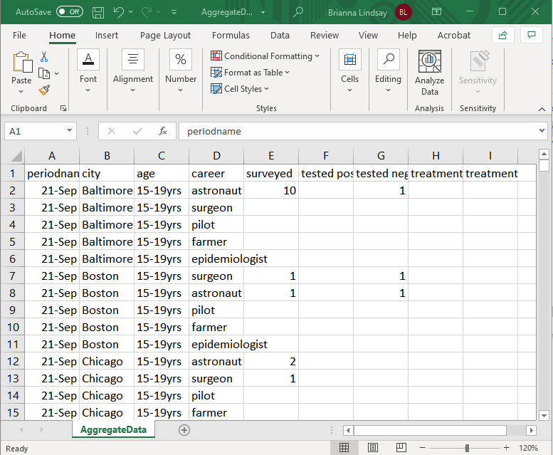
Grouping Aggregate Data
> library(summarytools)

Slide 9
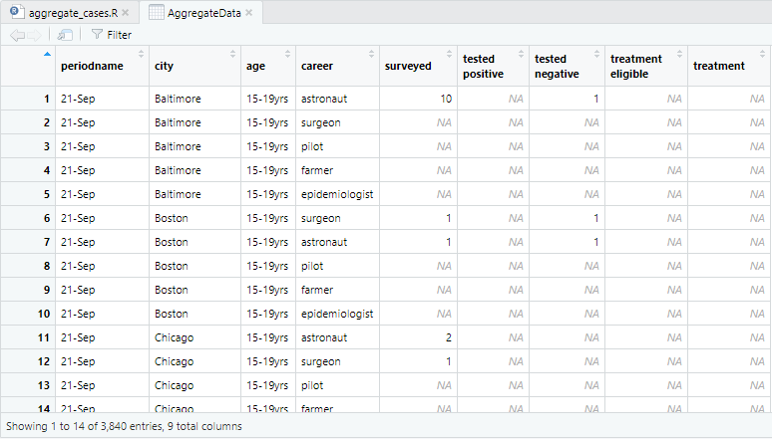
Grouping Aggregate Data
> library(summarytools)

Slide 10
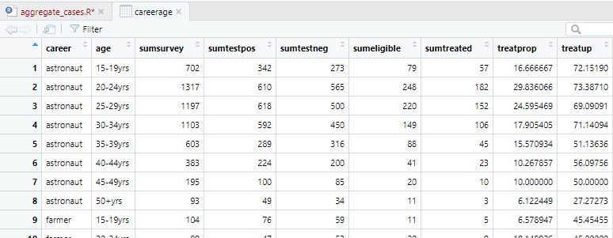
Grouping Aggregate Data
> library(summarytools)

Slide 11
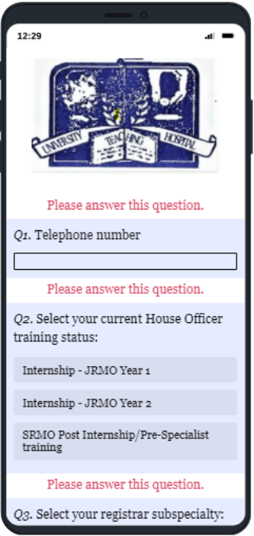
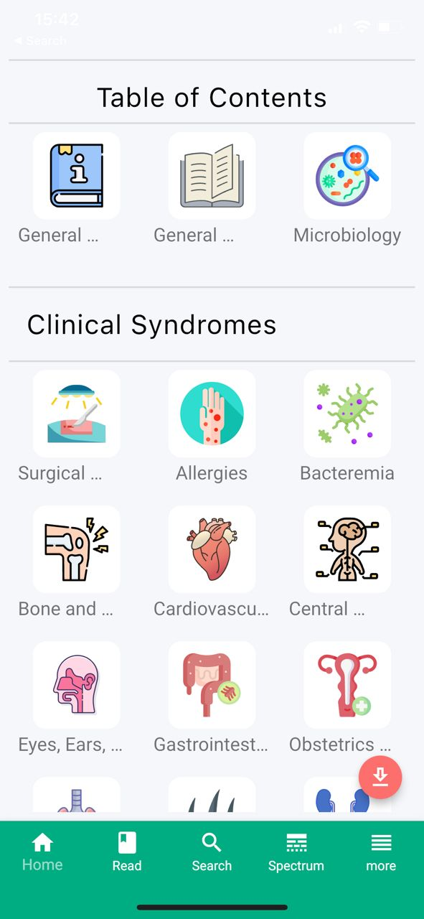
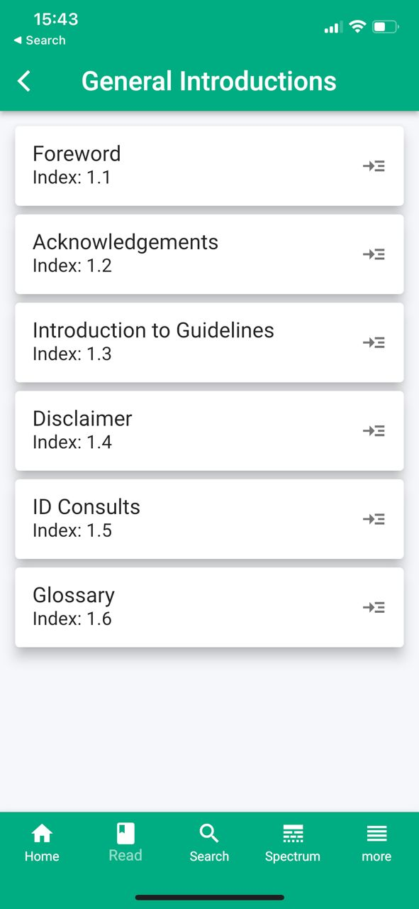
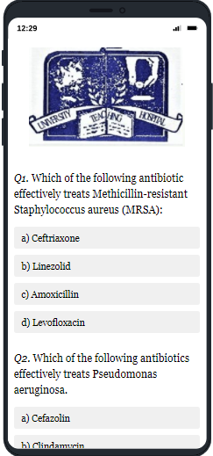
Pre-Post Analysis
> library(tidyverse)

Slide 12
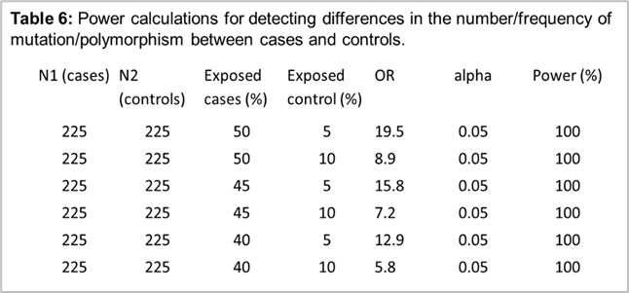
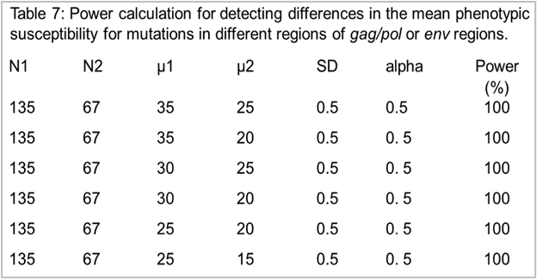
Power Analysis
> library(pwr)

Slide 13

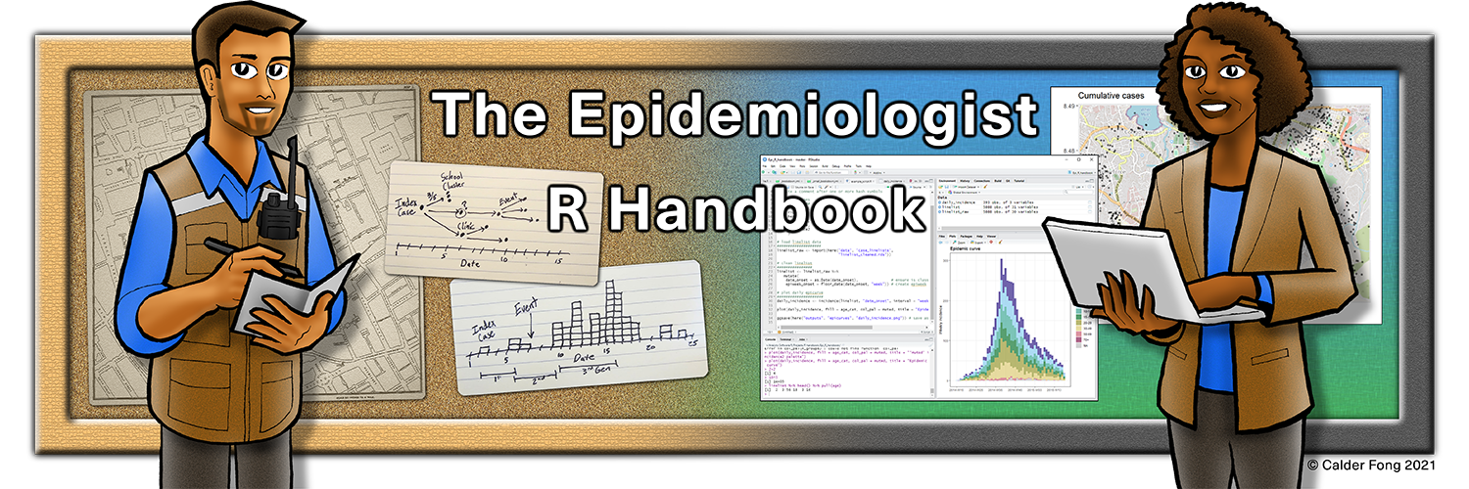
Resources
The Epidemiologist R Handbook - R for applied epidemiology
https://rladiessydney.org/courses/ryouwithme/01-basicbasics-0/
https://riffomonas.org/generalR/
Mutate and ifelse
CDC Managing Data Workbook
RECON Learn

